Slide 1
Sprocket Central Pty Ltd existing customer data Analysis
BY OYEWUSI OYEWALE CHARLES

Slide 2

Agenda:
Introduction
Data Exploration
Model Development
Interpretation

Slide 3

Introduction
Sprocket Central Pty Ltd is a long-standing KPMG client who specializes in high-quality bikes and accessible cycling accessories to riders. Their marketing team is looking to boost business by analyzing their existing customer dataset to determine customer trends and behavior.

Slide 4
Data Exploration
After careful Exploration of the dataset I found out that the 1000
Customer of Sprocket Central Pty Ltd to be targeted are Mass Customers, Customers that has no car and Female Customers.
Initial understanding of the dataset revels that the Mass Customers Segment of the wealth segment, customers that does not own a car as well as female customers constitute the larger percentage of Sprocket Central Pty Ltd customers as seen in the chart. They are thereby to be targeted to drive most value of the organization.
Place any suppoting images, graphs, data or extra text here.

Slide 5
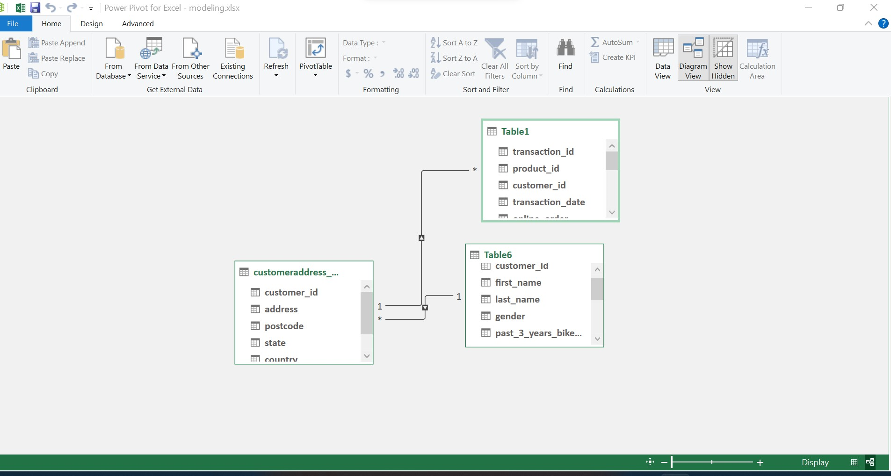
Model Development
I have created a simplified representation of the data set by creating a model of the three tables contain in the dataset.
At this stage of model development I move ahead by creating a model of the dataset and create relationship between the tables to facilitate analysis, and visualization. This has also help transform the data into a structured and understandable format, which will make it easy to see the relationship from the data. As showed in the diagram.
Note: The data modeling was done in Excel.

Slide 6
Interpretation
At the stage of Interpretation I present below the interpretation of the dataset as Analyzed.
This chart shows the distribution of customers by car. It illustrate that there are customers of Sprocket Central Pty Ltd that has no car
This chart shows the distribution of customers by wealth segment. It illustrate that there more mass customers of Sprocket Central Pty Ltd.
This chart shows the distribution of Gender. It illustrate that there are more Female of Customers.

Slide 7
This is the presentation of task two done according to the instruction given and given Template sample.
Thank you.

